Slide 1
CREDIT CARD FRAUD DETECTION SYSTEM USING MACHINE LEARNING
JAIVEER SINGH RATHORE

Slide 2
OVERVIEW
Objective of the Project
Introduction
Related Works
Proposed System
Block Diagram
Software Unit
Advantages
Limitations

Slide 3
OBJECTIVE
This project is to illustrate the modelling of a data set using machine learning with Credit Card Fraud Detection.
The Credit Card Fraud Detection Problem includes modelling past credit card transactions with the data of the ones that turned out to be fraud.
Machine learning algorithms are employed to analyze all the authorized transactions and report the suspicious ones.
Our objective here is to detect 100% of the fraudulent transactions while minimizing the incorrect fraud classifications.

Slide 4
INTRODUCTION
Credit card fraud is a huge ranging term for theft and fraud committed using or involving at the time of payment by using this card.
The purpose may be to purchase goods without paying, or to transfer unauthorized funds from an account
Fraud detection involves monitoring the activities of populations of users in order to estimate, perceive or avoid objectionable behaviour, which consist of fraud, intrusion, and defaulting

Slide 5
RELATED WORKS
[1]Deep Learning Methods for Credit Card Fraud Detection(Thanh Thi Nguyen, Hammad Tahir, Mohamed Abdelrazek, Ali Babar)
[2]Credit Card Fraud Detection Using Supervised Learning Approach (Rashmi S. More, Chetan J. Awati, Dr. Suresh K. Shirgave, Dr. Rashmi J. Deshmukh, Sonam S. Patil)
[3] Fabiana Fournier, Ivo carriea, Inna skarbovsky, The Uncertain Case of Credit Card Fraud Detection, The 9th ACM InternationalConference On Distributed Event Based Systems(DEBS15) 2015.
[4]. Yashvi Jain, Namrata Tiwari, ShripriyaDubey, Sarika Jain, A Comparative Analysis of Various Credit Card Fraud Detection
Techniques, Blue Eyes Intelligence Engineering And Sciences Publications 2019
[5]. Dinesh L. Talekar, K. P. Adhiya, Credit Card Fraud Detection System-A Survey, International journal of modern engineering
research(IJMER) 2014.
[6]. Samaneh Sorournejad, Zahra Zojaji, Reza Ebrahimi Atani, Amir Hassan Monadjemi, A Survey of credit card fraud detection
techniques: Data and techniques oriented perspective.
[7]. Lakshmi S V S S, Selvani Deepthi Kavila, Machine learning for credit card fraud detection system, International Journal Of
Applied Engineering Research ISSN 2018

Slide 6
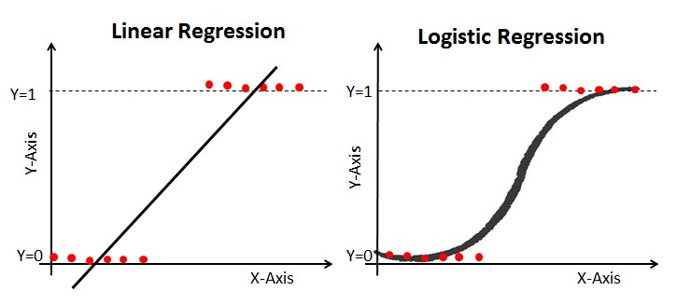
PROPOSED TECHNIQUE
Logistic Regression : Logistic Regression is a statistical model used for binary classification, for predictions of the type this or that, yes or no, A or B, etc. Logistic regression can be used for multiclass classification. It is one of the most frequently used machine learning algorithms for binary classifications that translates the input to 0 or 1.

Slide 7
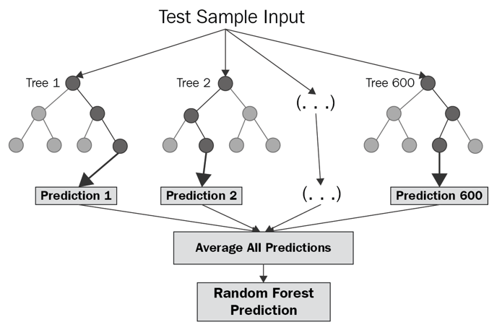
Random Forest is a Bagging technique, we use decision tree in the models to get it trained with the Data samples that are chosen using “Row sampling and feature sampling with replacement” method and test the models with test data and aggregate the all the outputs from models.

Slide 8
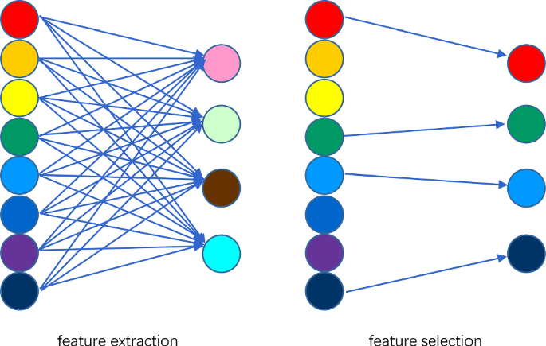
Feature Selection is the process of reducing the number of input variables when developing a predictive model. It is desirable to reduce the number of input variables to both reduce the computational cost of modeling and, in some cases, to improve the performance of the model. This method can be fast and effective, although the choice of statistical measures depends on the data type of both the input and output variables.

Slide 9
PROPOSED METHOD
Collecting Data First of all we need to collect data of previous credit card transactions. As the credit card data set is not available because of privacy issues we can use the dataset with time period of two months
Cleaning Data and Pre-processing To make the data ready for modelling we need to avoid unrelated variables, check for unusual entries, Remove columns with high number of missing values.

Slide 10
Class Imbalance Problem This is the issue that occurs as there are only few fraud transactions are in the huge data of genuine transactions.
Example : 1 in 600 transactions are noted to be fraud
Building Random Forest
Random forest performing well in handling huge amount of highly imbalanced datasets in minimum amount of time. With the accuracy of 90%

Slide 11
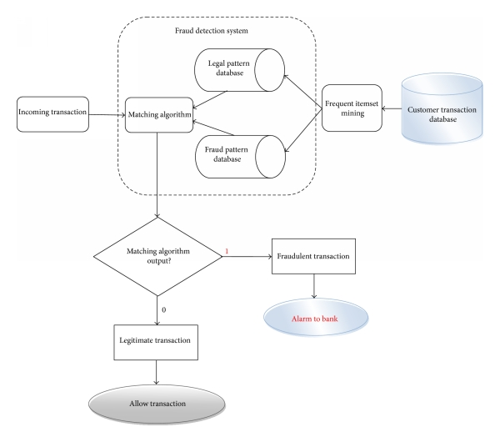
BLOCK DIAGRAM

Slide 12
SOFTWARE UNIT
Python 3
NumPy (package) for data analysis
R Programming

Slide 13
ADVANTAGES
Higher accuracy of fraud detection machine learning tools have higher precision and return more relevant results as they consider multiple additional factors.
Fewer false declines. False declines or false positives happen when a system identifies a legitimate transaction as suspicious and wrongly cancels it.
Ability to identify new patterns and adapt to changes. Unlike rule-based systems, ML algorithms are aligned with a constantly changing environment and financial conditions.

Slide 14
LIMITATIONS
Machine learning algorithms work only for huge sets of data. For smaller amount of data the results may be not accurate.
It takes a significant amount of data for machine learning models to become accurate.
For large organizations, this data volume is not an issue but for others, there must be enough data points to identify legitimate cause and effect relations.
To build a machine learning system in-house, companies will have to hire not just one, but a team of data scientists to design and continually update the system. As there are massive amounts of data involved, businesses also need to invest in data storage and management, which will eat up more network space.

Slide 15
REFERENCES
REFERENCES [1] “Credit Card Fraud Detection Based on Transaction Behaviour -by John Richard D. Kho, Larry A. Vea” published by Proc. of the 2017 IEEE Region 10 Conference (TENCON), Malaysia, November 5-8, 2017
[2] CLIFTON PHUA1, VINCENT LEE1, KATE SMITH1 & ROSS GAYLER2 “ A Comprehensive Survey of Data Mining-based Fraud Detection Research” published by School of Business Systems, Faculty of Information Technology, Monash University, Wellington Road, Clayton, Victoria 3800, Australia

